Slide 1
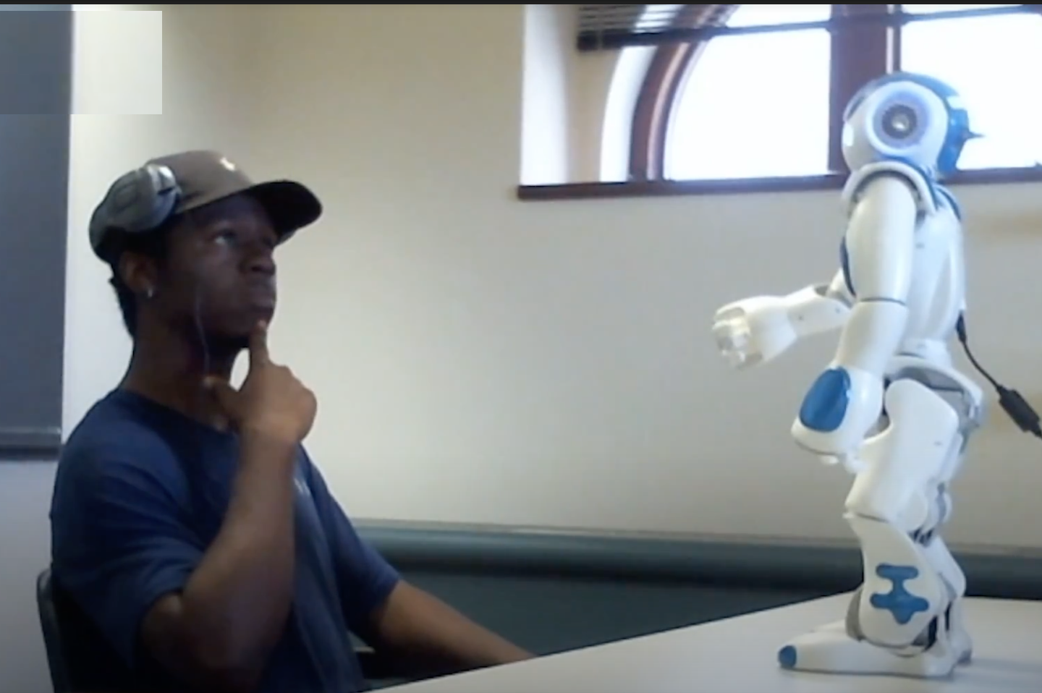
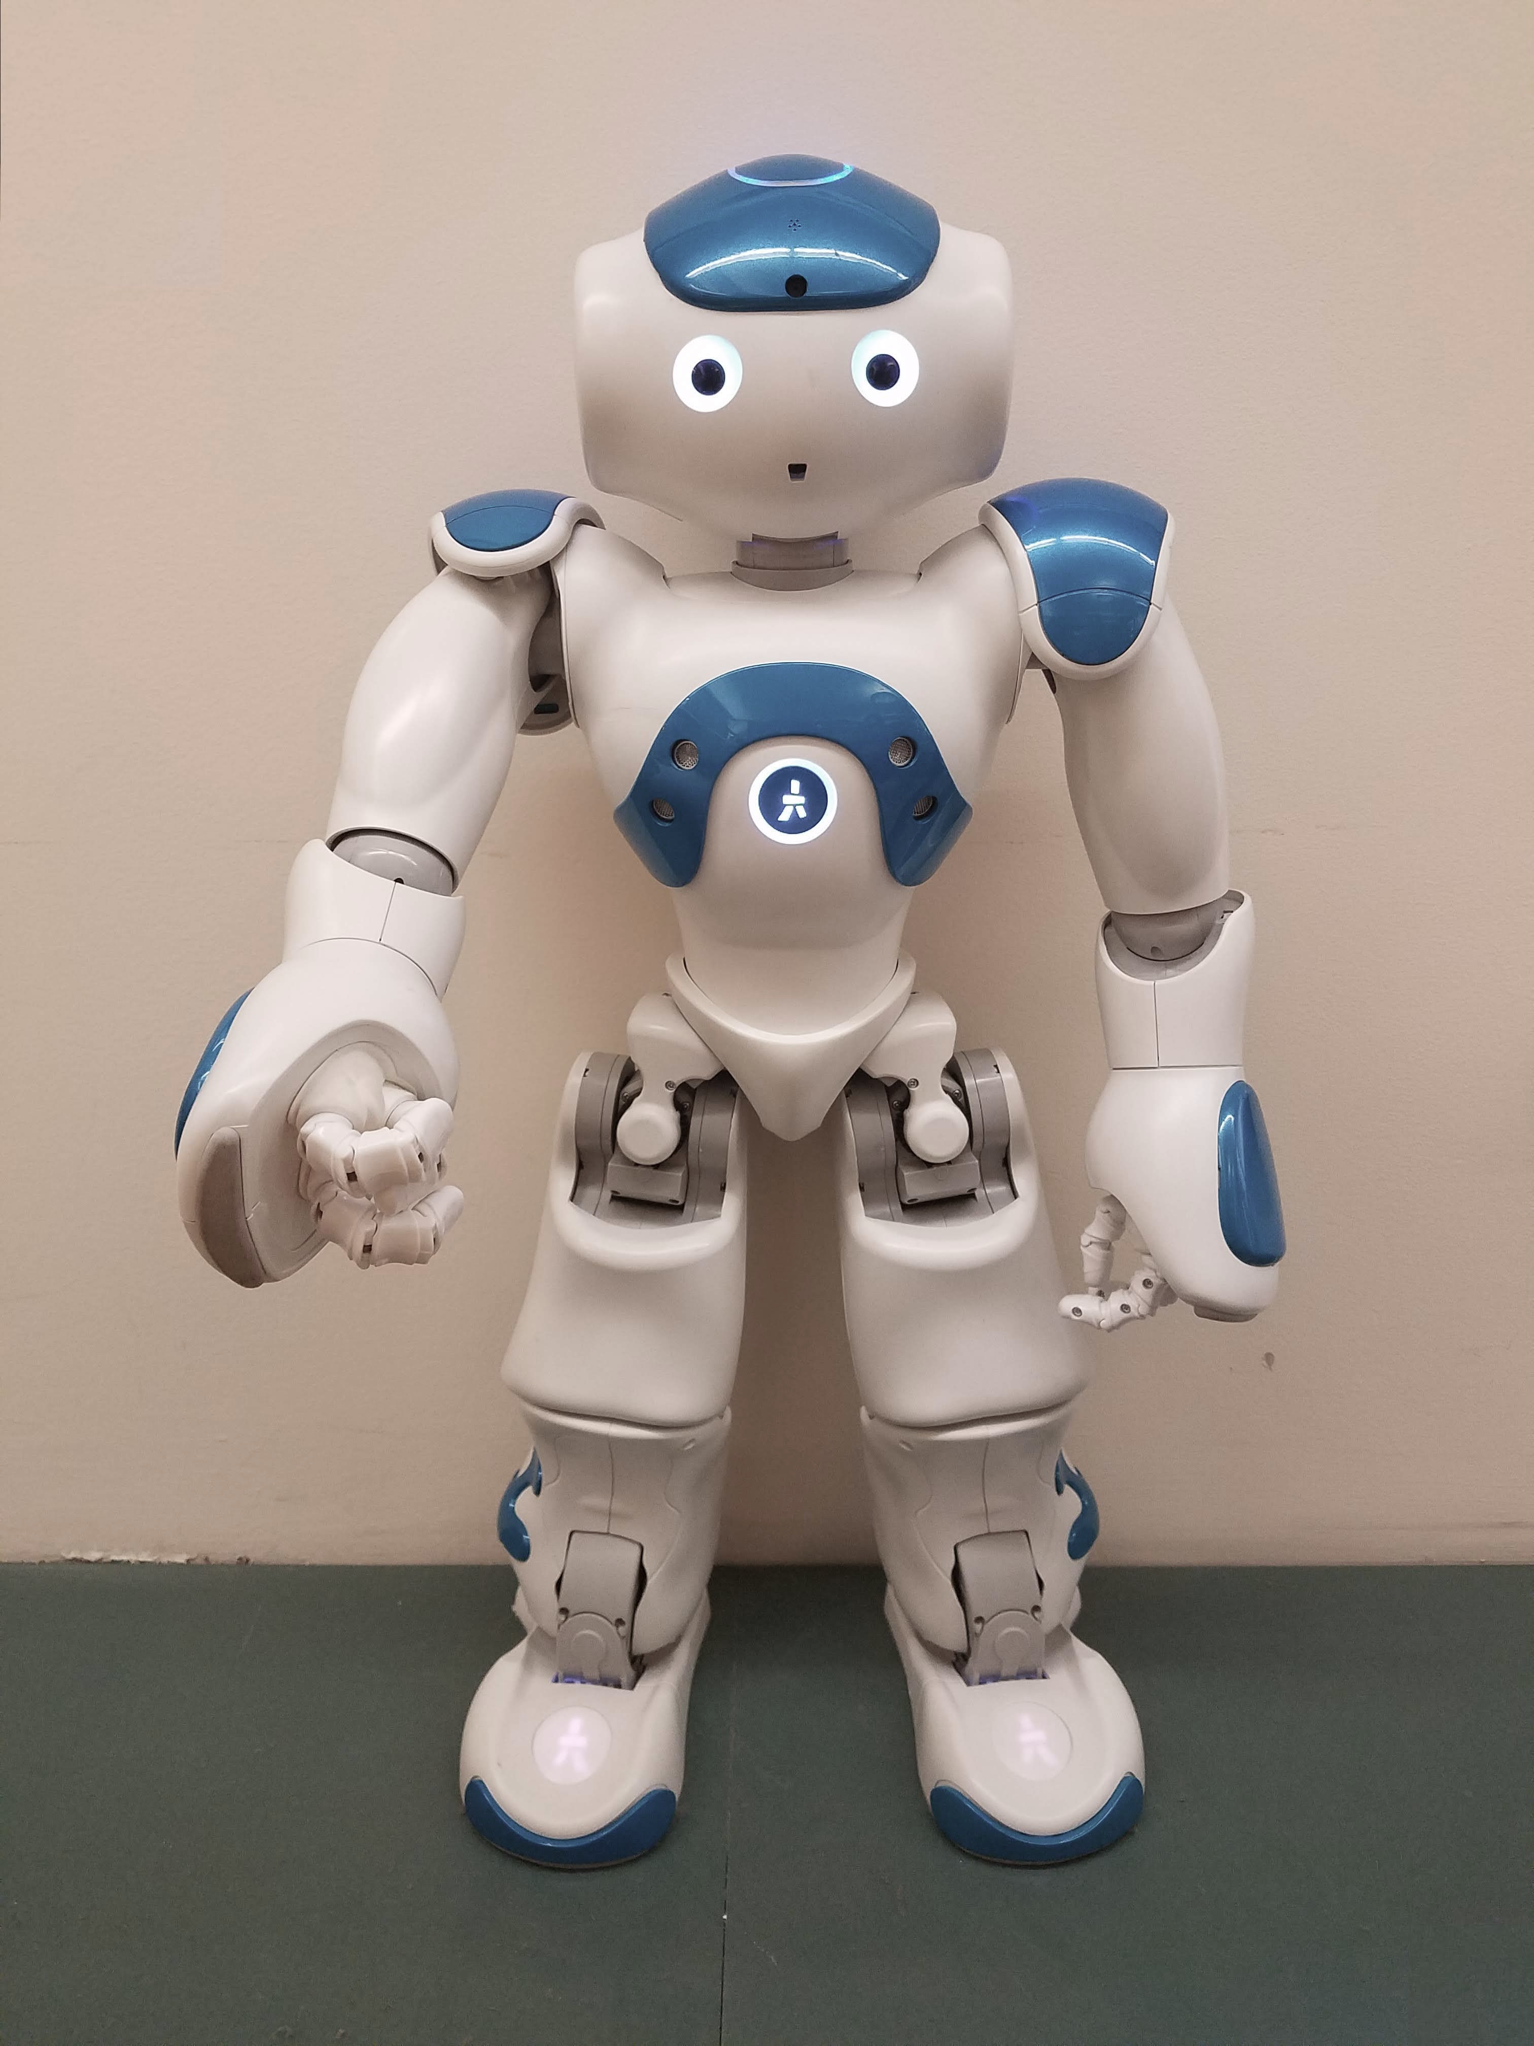
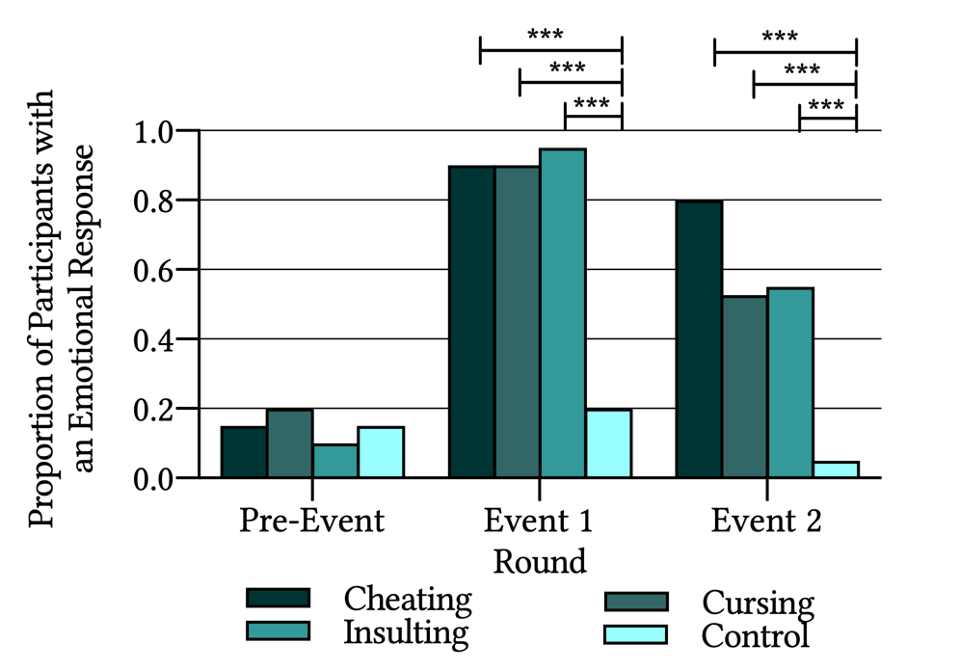
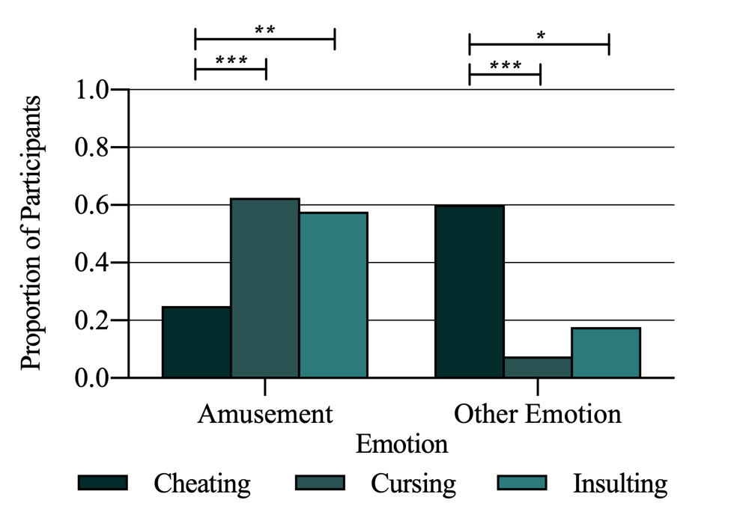
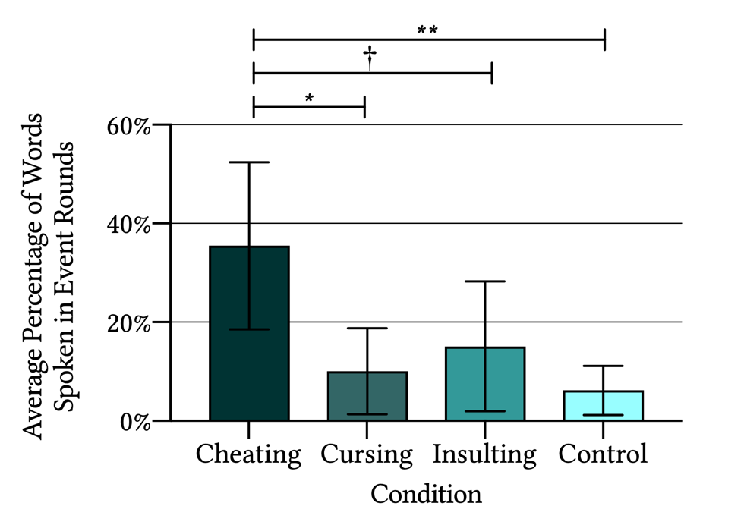
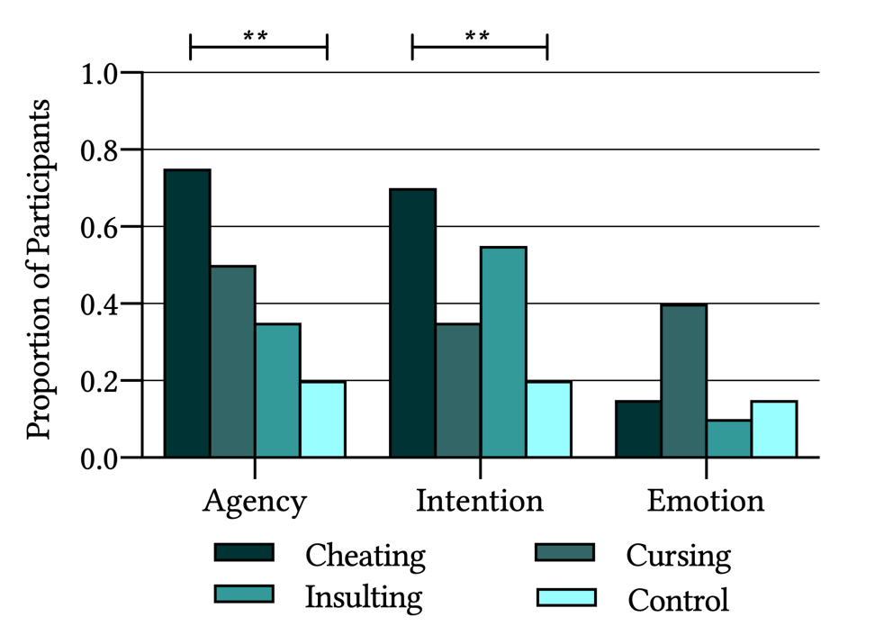
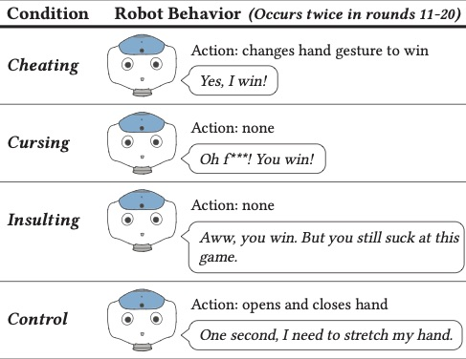
Perceived Agency of a Social Norm Violating Robot
Shannon Yasuda, Devon Doheny, Nicole Salomons, Sarah Strohkorb Sebo, Brian Scassellati
Social Robotics Lab, Department of Computer Science
Yale University, New Haven, CT
Objective
Previous studies have shown that people are more likely to assign agency to a robot that cheats (Short et al., 2010; Litoiu et al.2015). One possible explanation for this phenomenon is that cheating belongs to a broader category of “social norm violations” which all elicit similar responses (Korman et al., 2019)
In this study, we seek to explore this theory, observing how social norm violations affect perceptions of agency.
Results
One second. I need to stretch my hand
One second. I need to stretch my hand.
Methodology
Participants played 30 rounds of rock-paper-scissors with a Nao robot (pictured below). In the first and last 10 rounds of the game, the robot played the game normally,.
Between rounds 11 and 20, the robot would commit a special behavior the first two times it lost. These behaviors are described in the figure below.
A participant reacting to the robot cursing
A participant reacting to the robot cheating
A participant reacting to the robot insulting them
A participant reacting to the robot stretching its hand
Emotional Reactions
Verbal Response
Post-Game Survey Response
We split emotions into two categories: neutral and emotive and compared each condition using a Chi-Squared Test of Independence Participants in the social norm violation conditions displayed larger variance in emotional expression than participants in the control condition
Facial expressions were coded into 4 emotions: amusement, anger, confusion, and surprise. Grouping anger, confusion, and surprise, we conducted another Chi-Squared Test of Independence. Participants in the cheating condition expressed a significantly greater variety of emotions compared to the cursing and insulting conditions.
We divided the number of words that a participant spoke during event rounds by the total number of words that participant spoke throughout the experiment to see how likely it was that an event elicited a social response. We ran a one-way ANOVA. Cheating elicited the greatest increase in verbal engagement immediately following the social norm violation, significantly more than the control.
We coded participants’ written responses to the post-game survey to infer if they perceived the robot as an agent, as having beliefs, intentions, or desires, or as having emotions. We compared each condition using a Chi-Squared Test of Independence. Participants ascribed more agency and more beliefs, intentions, and desires to the robot in the cheating condition compared to the control condition.
Discussion
Participants show signs of immediate social norm violation detection when a robot violates any social norm.
Participants show greater signs of immediate social norm violation detection when a robot cheats compared to any other social norm violation.
Participants have greater agentic perceptions of a robot that cheats compared to any other social norm violation.
Participants did not show significantly greater agentic perceptions of a robot that violates any social norm.
We therefore do not find support for the theory that cheating elicits greater agentic perceptions due to its classification as a social norm violation. Future studies should seek to further explore this theory, perhaps examining stronger social norm violations in more realistic settings.
Acknowledgments
This work was supported by the National Science Foundations award IIS-1813651. We would like to thank Sarah Wagner, David Shin, and Nikola Kamcev for contributing to the methodology of this project. Additionally we would like to thank Alex Litoiu, Daniel Ullman, and Jason Kim for graciously sharing the code and protocols followed for their study (Litoiu et al., 2015). We would also like to extend our thanks to the Yale University Computer Science Department for supporting this project.
References
Korman, J., Harrison, A., McCurry, M., & Trafton, G. (2019). Beyond programming: can robots’ norm-violating actions elicit mental state attributions? In 2019 14th acm/ieee international conference on human-robot interaction (hri) (pp. 530–531).
Litoiu, A., Ullman, D., Kim, J., & Scassellati, B. (2015). Evidence that robots trigger a cheating detector in humans. In Proceedings of the tenth annual acm/ieee international conference on human-robot interaction (pp. 165–172).
Short, E., Hart, J., Vu, M., & Scassellati, B. (2010). No fair!! an interaction with a cheating robot. In 2010 5th acm/ieee international conference on human-robot interaction (hri) (pp. 219–226).

